Slide 1
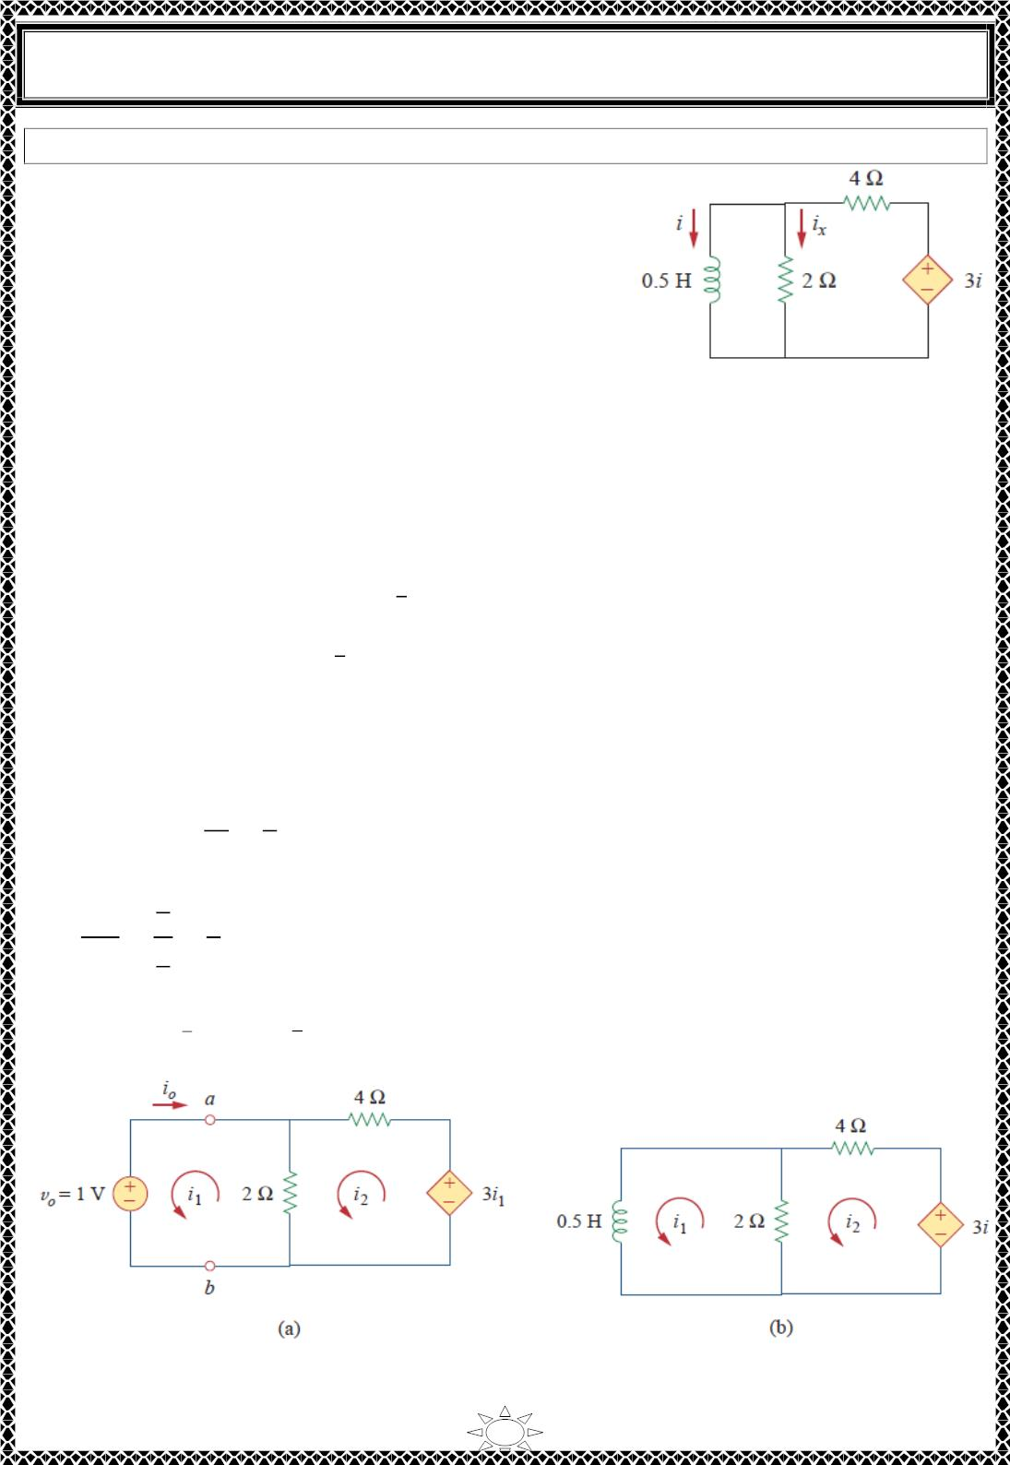
University of Diyala
Engineering College
Electrical Circuits
Example 3: Assuming that ꢀ(푂) = 10퐴, calculate ꢀ(푡) and ꢀ_{푥}(푡) in the circuit of Fig.1.
Solution:
There are two ways we can solve this problem. One
way is to obtain the equivalent resistance at the inductor
terminals and then use Eq. (3.8). The other way is to
start from scratch by using Kirchhoff’s voltage law.
Whichever approach is taken, it is always better to first
obtain the inductor current.
Fig.1
METHOD 1 The equivalent resistance is the same as the Thevenin resistance at the
inductor terminals. Because of the dependent source, we insert a voltage source with 푣_{표} =
1푉 at the inductor terminals a‐b, as in Fig. 2(a). (We could also insert a 1‐퐴 current source
at the terminals.) Applying KVL to the two loops results in
ꢁ
2(ꢀ − ꢀ ) + 1 = 0 ⇒ ꢀ − ꢀ = −
(1)
(2)
ꢁ
ꢂ
ꢁ
ꢂ
ꢂ
5
6ꢀ − 2ꢀ − 3ꢀ = 0 ⇒ ꢀ = ꢀ
ꢁ
ꢂ
ꢁ
ꢁ
ꢂ
Trail Version
Trail Version
Trail Version
Trail Version
Trail Version
Trail Version
Trail Version
Trail Version
Trail Version
Trail Version
Trail Version
Trail Version
Trail Version
ꢃ
Substituting Eq. (2) into Eq. (1) gives
ꢀ = −3퐴 ꢀ = −ꢀ = 3퐴
ꢁ
표
ꢁ
∴ 푅_{푒푞} = 푅_{푇ℎ}
푣_{표}
ꢀ_{표}
1
=
= 훺
3
퐿
1
2
1
3
3
휏 =
=
= 푠
2
푅_{푒푞}
ꢆ
ꢇ
ꢂ
ꢀ(푡) = ꢀ(0)ꢄ^{ꢅ} = 10ꢄ
ꢅꢈ ꢊꢆ
퐴
ꢉ
푡 > 0
Fig. 2
8

Slide 2
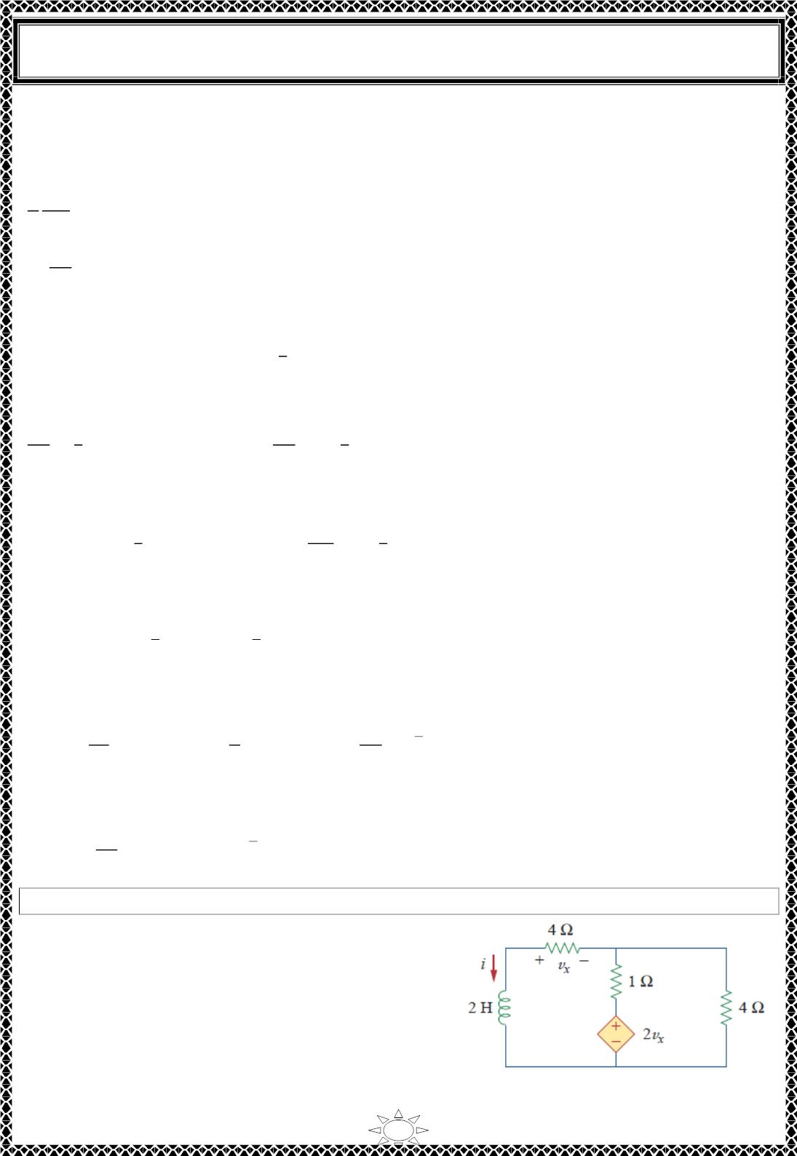
University of Diyala
Engineering College
Electrical Circuits
METHOD 2 We may directly apply KVL to the circuit as in Fig. 2(b).
For loop 1,
1 푑ꢀꢁ
2 푑푡
+ 2(ꢀ − ꢀ ) = 0
ꢁ
ꢂ
^{ꢃꢄ}ꢅ
∴
+ 4ꢀ − 4ꢀ = 0
(1)
(2)
ꢃꢆ
ꢁ
ꢂ
For loop 2,
6 ꢀ − 2ꢀ − 3ꢀ = 0 ⇒ ꢀ = ꢀ
ꢁ
ꢂ
ꢁ
ꢁ
ꢂ
5
ꢇ
Substituting Eq. (2) into Eq. (1) gives
^{ꢃꢄ}ꢅ
ꢃꢆ
ꢂ
ꢃꢄ_{ꢅ}
ꢄ_{ꢅ}
ꢂ
= − 푑푡
ꢈ
+ ꢀ = 0
⇒
ꢈ
ꢁ
Since ꢀ = ꢀ, we may replace ꢀ with ꢀ and integrate:
ꢁ
ꢁ
Trail Version
Trail Version
Trail Version
Trail Version
Trail Version
Trail Version
Trail Version
Trail Version
Trail Version
Trail Version
Trail Version
Trail Version
Trail Version
ꢄ(ꢆ)
ꢄ(ꢉ)
ꢂ
= − 푡|
ꢈ
ꢄ(ꢆ)
ꢄ(ꢉ)
ꢂ
= − 푡
ꢈ
ln ꢀ|
ꢆ
⇒
ln
ꢉ
Taking the powers of 푒, we finally obtain
ꢀ(푡) = ꢀ(0)푒
ꢂ
ꢊꢋ ꢌꢆ
ꢈ
= 10푒
ꢂ
ꢊꢋ ꢌꢆ
ꢈ
퐴
푡 > 0
which is the same as by Method 1.
푑ꢀ
푑푡
2
10
ꢂ
ꢊꢋ ꢌꢆ
ꢈ
푣_{퐿} = ꢍ
= 0.ꢎ(10)(− )푒^{ꢊ(ꢂ/ꢈ)ꢆ} = −
푒
푉
3
3
Since the inductor and the 2 − 훺 resistor are in parallel, (푣 = 푣 )
퐿
푅
^{푣}푅
2
ꢂ
ꢊꢋ ꢌꢆ
ꢈ
ꢀ_{푥}(푡) =
= −1.6667푒
퐴
푡 > 0
H.W.3: Find ꢀ and 푣 in the circuit of Fig. 1. Let ꢀ(푂) = ꢎ A.
_{Answer: ퟓ풆}^{ꢊퟒ풕}푽
푥
−ퟐퟎ풆^{ꢊퟒ풕}푽.
Fig. 1.
9

Slide 3
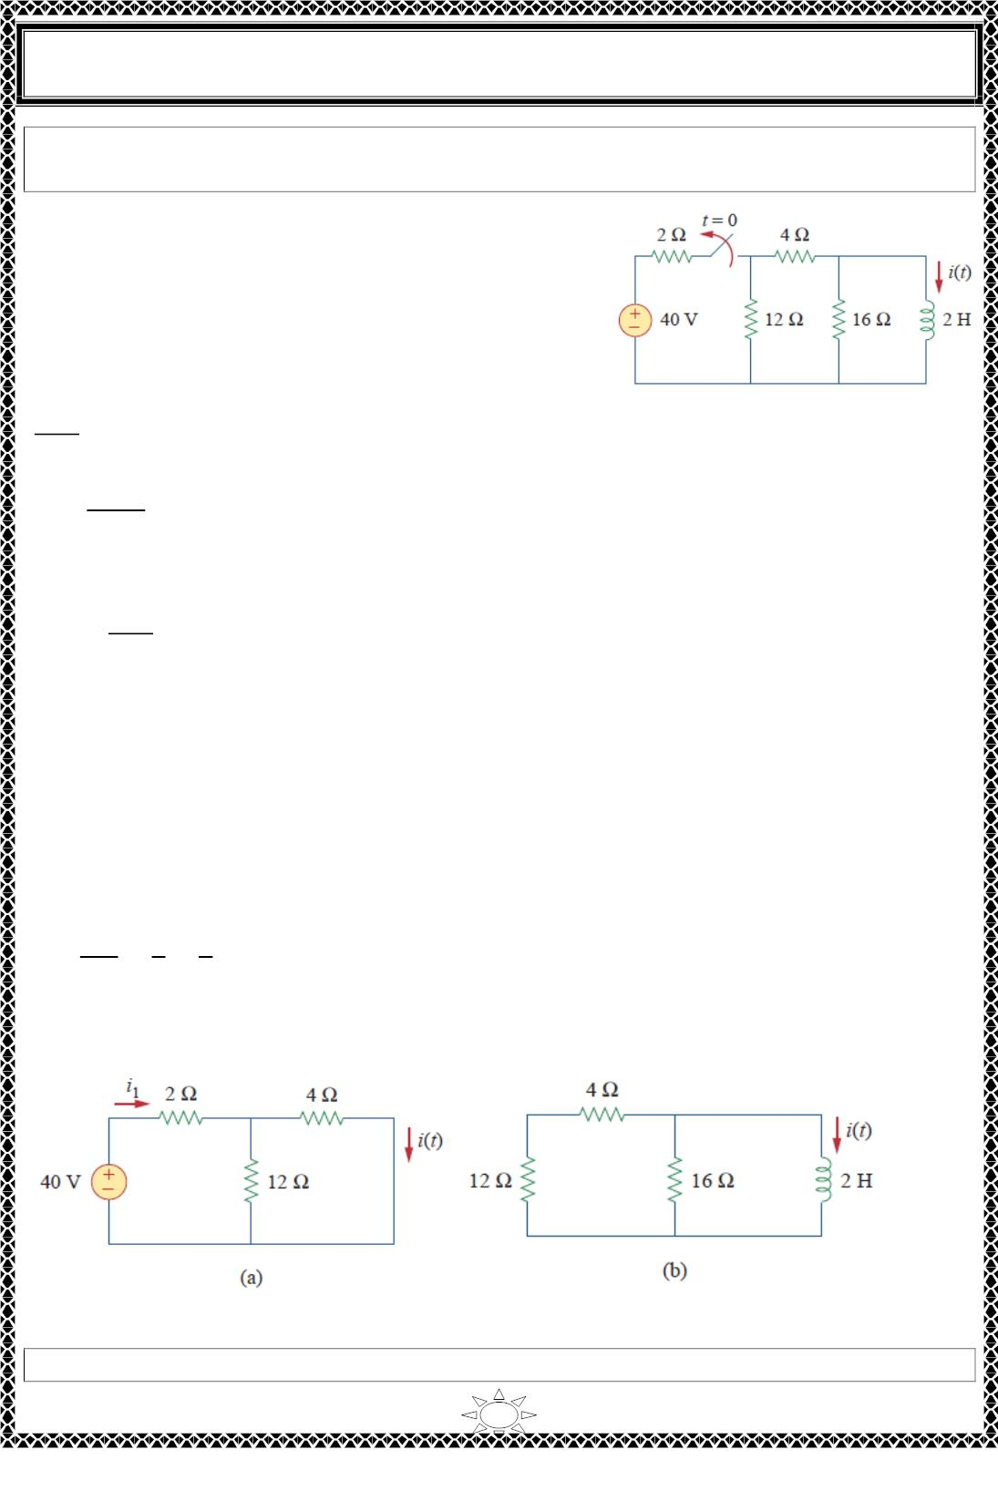
University of Diyala
Engineering College
Electrical Circuits
Example 4: The switch in the circuit of Fig. 1. has been closed for a long time. At 푡 = 0,
the switch is opened. Calculate ꢀ(푡) for 푡 > 0.
Solution:
When 푡 < 0, the switch is closed, and the inductor
acts as a short circuit to 푑푐. The 16 − 훺 resistor is
short‐circuited; the resulting circuit is shown in Fig.
2(a). To get ꢀꢁ in Fig. 2(a), we combine the 4 − 훺 and
12 − 훺 resistors in parallel to get
ꢂ×ꢁꢃ
= 3훺
Fig. 1.
ꢂ+ꢁꢃ
ꢀꢁ =
40
= 8퐴
2 ꢄ 3
We obtain ꢀ(푡) from ꢀꢁ in Fig. 2(a) using current division, by writing
ꢀ(푡) =
ꢁꢃ
ꢀꢁ = 6퐴, 푡 < 0
ꢁꢃ+ꢂ
Trail Version
Trail Version
Trail Version
Trail Version
Trail Version
Trail Version
Trail Version
Trail Version
Trail Version
Trail Version
Trail Version
Trail Version
Trail Version
Since the current through an inductor cannot change instantaneously,
ꢀ(푂) = ꢀ(0^{ꢅ}) = 6퐴
When 푡 > 0, the switch is open and the voltage source is disconnected. We now have the
source‐free 푅퐿 circuit in Fig. 2(b).
푅_{푒푞} = (12 ꢄ 4)‖16 = 8훺
퐿
2
8
휏 =
=
1
= 푠
4
푅_{푒푞}
∴ ꢀ(푡) = ꢀ(0)ꢆ^{ꢅꢇ/ꢈ} = 6ꢆ^{ꢅꢂꢇ}퐴
Fig. 2 Solving the circuit of Fig.1: (a) for t < 0, (b) for t > 0.
H.W.4: For the circuit in Fig.1, find ꢀ(푡) for 푡 > 0.
10

Slide 4
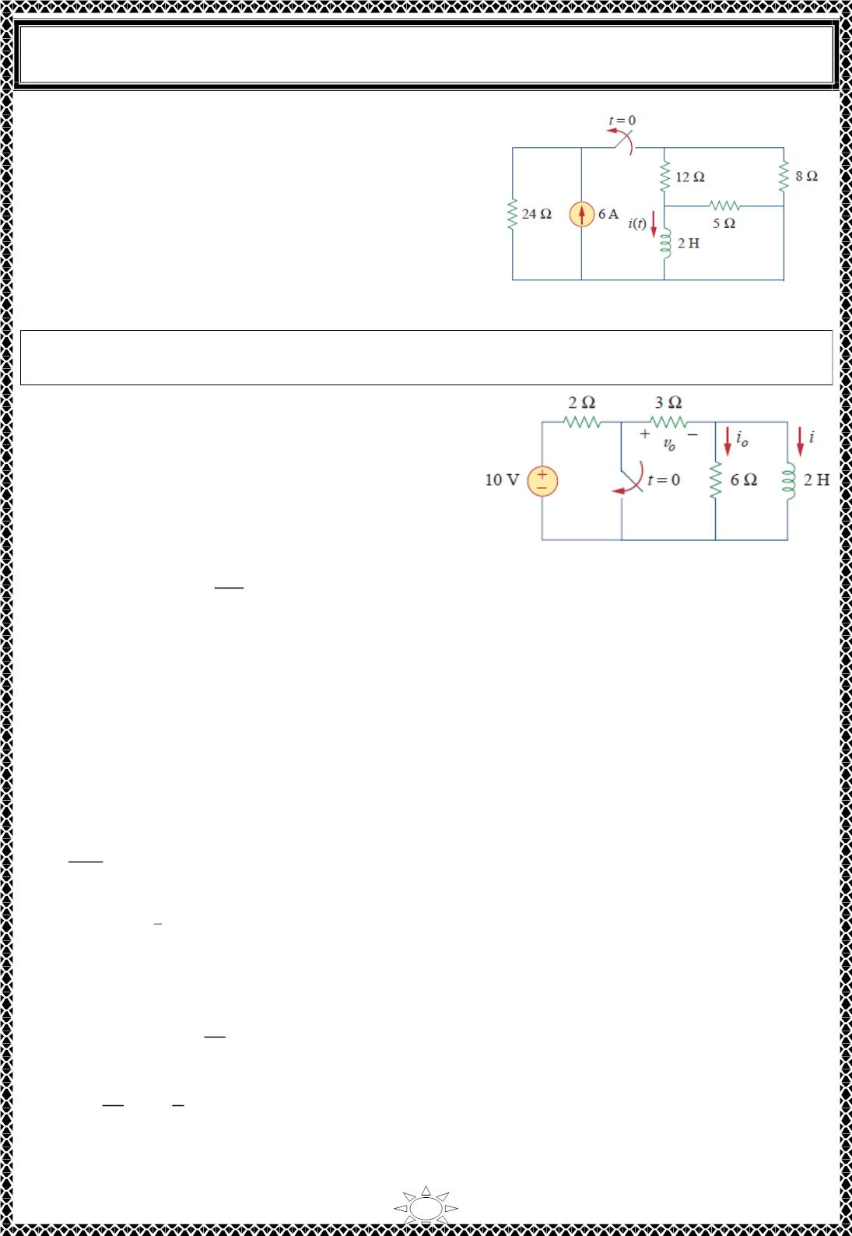
University of Diyala
Engineering College
Electrical Circuits
Answer: 2e^{-2t} A, t > 0
Fig.1
Example 5: In the circuit shown in Fig.1, find ꢀ , 푣 , and ꢀ for all time, assuming that the
switch was open for a long time.
표
표
Solution: It is better to first find the inductor
current ꢀ and then obtain other quantities from it.
For 푡 < 0, the switch is open. Since the inductor
acts like a short circuit to 푑푐, the 6 − 훺 resistor is
short‐circuited, so that we have the circuit shown
in Fig.2 (a). Hence,
Trail Version
Trail Version
Trail Version
Trail Version
Trail Version
Trail Version
Trail Version
Trail Version
Trail Version
Trail Version
Trail Version
Trail Version
Trail Version
1ꢁ
Fig.1
ꢀ_{표} = 0, and ꢀ(푡) =
= ꢂ퐴.
푡 < 0
2+3
푣_{표}(푡) = ꢃꢀ(푡) = 6푉. 푡 < 0
Thus, ꢀ(푂) = ꢂ.
For 푡 > 0, the switch is closed, so that the voltage source is short‐ circuited. We now have
a source‐free 푅퐿 circuit as shown in Fig.2 (b). At the inductor terminals,
푅_{푇ℎ} = ꢃ‖6 = ꢂ훺
퐿
휏 =
^{푅}푇ℎ
= ꢄ푠
ꢆ
ꢇ
ꢀ(푡) = ꢀ(0)푒^{ꢅ} = ꢂ푒^{ꢅꢆ}퐴.
푡 > 0
Since the inductor is in parallel with the 6 − 훺 and ꢃ − 훺 resistors,
푑ꢀ
= −ꢂ(−ꢂ푒^{ꢅꢆ}) = 4푒^{ꢅꢆ}푉.
푣 (푡) = −푣 = −퐿
푡 > 0
표
ꢈ
푑푡
푣_{ꢈ}
6
ꢂ
ꢀ_{표}(푡) =
= − 푒^{ꢅꢆ}퐴.
푡 > 0
ꢃ
Thus, for all time,
11

Slide 5
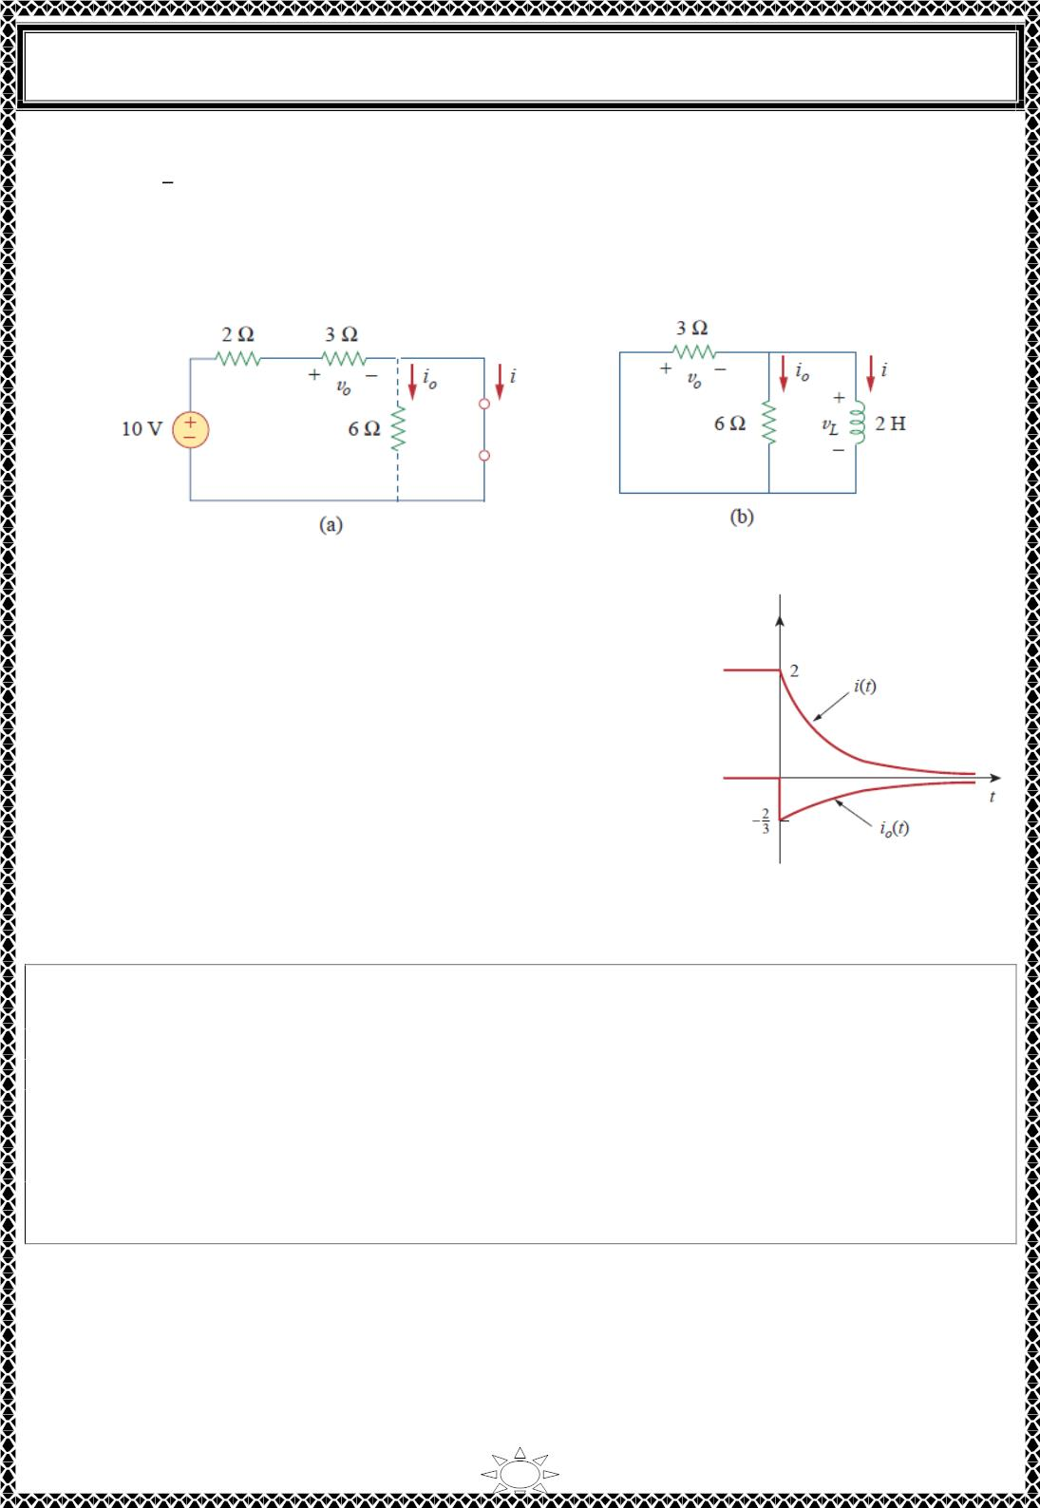
University of Diyala
Engineering College
Electrical Circuits
ꢀ표^{(푡) = {}
푂퐴
푡 < 0
푡 > 0
,
푣_{표}(푡) = ꢃ
6 푉
_{4푒}ꢁꢂ
푡 < 0
푡 > 0
2
− 푒^{ꢁꢂ} 퐴
푉
3
ꢀ(푡) = ꢃ
ꢄ퐴
ꢄ푒^{ꢁꢂ}퐴
푡 < 0
푡 ≥ 0
Fig.2. The circuit in Fig.1 for: (a) 푡 < 0 (b) 푡 > 0
We notice that the inductor current is continuous at 푡 = 0,
while the current through the 6 − 훺 resistor drops from 0 to
−ꢄ/ꢅ at 푡 = 0, and the voltage across the ꢅ − 훺 resistor
drops from 6 to 4 at 푡 = 0. We also notice that the time
constant is the same regardless of what the output is defined
to be. Fig.3. plots ꢀ and ꢀ_{표}.
Trail Version
Trail Version
Trail Version
Trail Version
Trail Version
Trail Version
Trail Version
Trail Version
Trail Version
Trail Version
Trail Version
Trail Version
Trail Version
Fig.3. A plot of ꢀ and ꢀ_{표}
H.W.5: Determine ꢀ, ꢀ , and 푣 for all 푡 in the circuit shown in Fig.1. Assume that the
표
표
switch was closed for a long time. It should be noted that opening a switch in series with
an ideal current source creates an infinite voltage at the current source terminals. Clearly
this is impossible. For the purposes of problem solving, we can place a shunt resistor in
parallel with the source (which now makes it a voltage source in series with a resistor). In
more practical circuits, devices that act like current sources are, for the most part,
electronic circuits. These circuits will allow the source to act like an ideal current source
over its operating range but voltage‐limit it when the load resistor becomes too large (as in
an open circuit).
ퟏퟐ푨
Answer: 풊 = ꢃ
ퟏퟐ풆^{ꢁퟐ풕}푨 풕 ≥ ퟎ ’
풕 < ퟎ
ퟔ푨
풕 < ퟎ
ퟐퟒ푽 풕 < ퟎ
풗_{풐} = ꢃ
ퟖ풆^{ꢁퟐ풕}푽 풕 > ퟎ
풊_{풐} = ꢃ
−ퟒ풆^{ꢁퟐ풕}푨 풕 > ퟎ ’
12

Slide 6
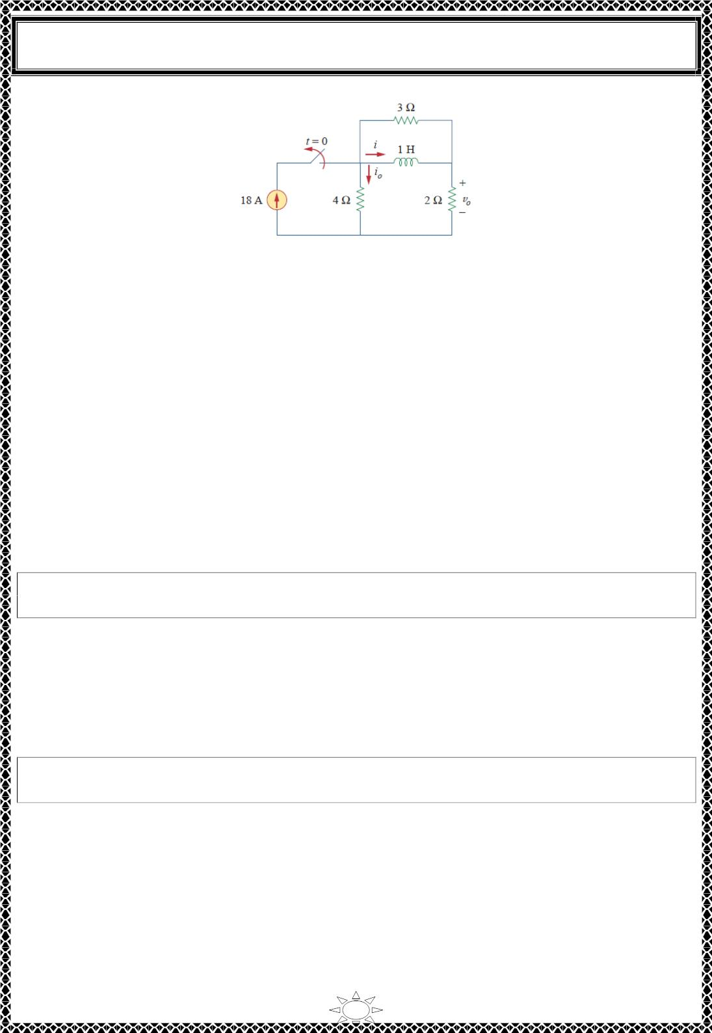
University of Diyala
Engineering College
Electrical Circuits
Fig.1
4) Singularity Functions
A basic understanding of singularity functions will help us make sense of the response of
first‐order circuits to a sudden application of an independent dc voltage or current source.
Singularity functions (also called switching functions) are very useful in circuit analysis.
They serve as good approximations to the switching signals that arise in circuits with
switching operations. They are helpful in the neat, compact description of some circuit
phenomena, especially the step response of 푅퐶 or 푅퐿 circuits .
Trail Version
Trail Version
Trail Version
Trail Version
Trail Version
Trail Version
Trail Version
Trail Version
Trail Version
Trail Version
Trail Version
Trail Version
Trail Version
Singularity functions are functions that either are discontinuous or have
discontinuous derivatives.
The three most widely used singularity functions in circuit analysis are:
1. the unit step function.
2. the unit impulse function.
3. the unit ramp function.
4.1) Unit step function
The unit step function u(t) is 0 for negative values of t and 1 for positive values of
t.
The unit step function is undefined at 푡 = 0, where it changes abruptly from 0 to 1 (shown
in Fig.4.1). It is dimensionless, like other mathematical functions such as sine and cosine.
In mathematical terms,
푢(푡) = {
0, 푡 < 0
1, 푡 > 0
(4.1)
13

Slide 7
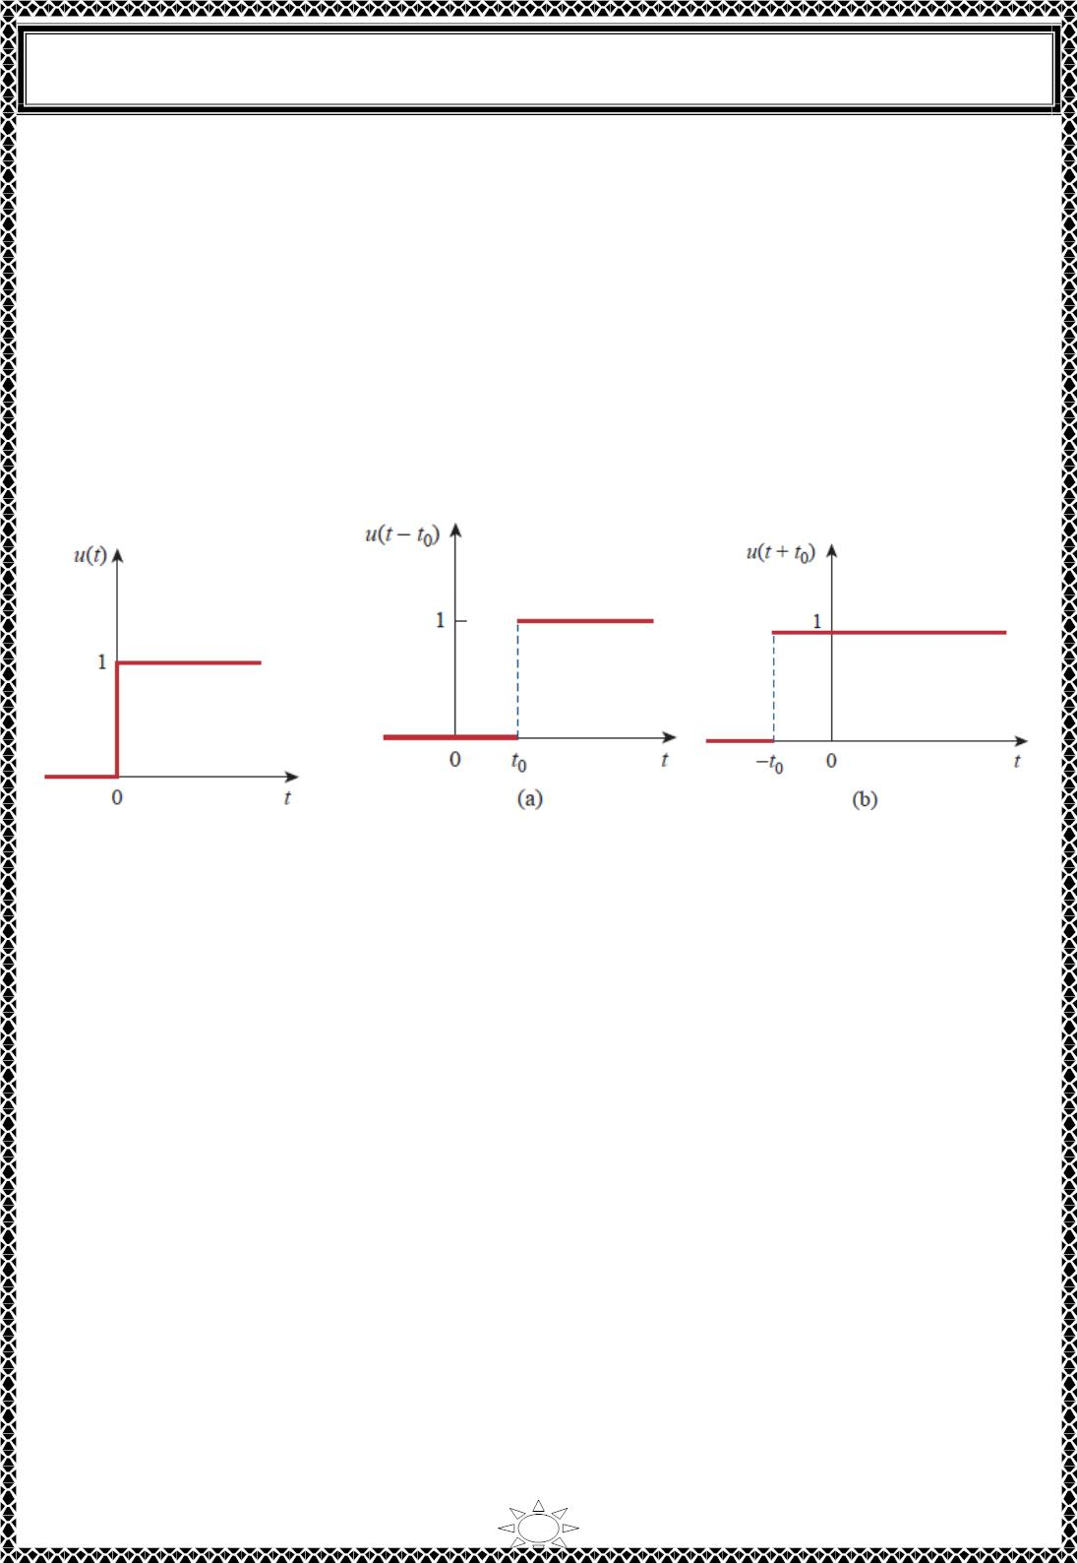
University of Diyala
Engineering College
Electrical Circuits
If the abrupt change occurs at 푡 = 푡 (where 푡 > ꢀ) instead of 푡 = ꢀ, which is the same as
0
0
saying that 푢(푡) is delayed by 푡₀ seconds, as shown in Fig.4.2(a), the unit step function
becomes
푢(푡 − 푡_{표}) = {
ꢀ, 푡 < 푡_{표}
(4.2)
1, 푡 > 푡_{표}
If the change is at 푡 = −푡 , meaning that 푢(푡) is advanced by 푡 seconds, Fig.4.2(b), the
0
0
unit step function becomes
ꢀ, 푡 < −푡_{표}
푢(푡 + 푡_{표}) = {
(4.3)
1, 푡 > −푡_{표}
Trail Version
Trail Version
Trail Version
Trail Version
Trail Version
Trail Version
Trail Version
Trail Version
Trail Version
Trail Version
Trail Version
Trail Version
Trail Version
Fig.4.1The unit step function.
Fig.4.2 The unit step function
(a) delayed by t (b) advanced by t .
0
0
We use the step function to represent an abrupt change in voltage or current, like the
changes that occur in the circuits of control systems and digital computers. For example,
the voltage
푣(푡) = {
ꢀ, 푡 < 푡₀
(4.4)
(4.5)
푉₀, 푡 > 푡₀
may be expressed in terms of the unit step function as
푣(푡) = 푉 푢(푡 − 푡 )
0
0
If we let 푡 = ꢀ then 푣(푡)is simply the step voltage 푉 푢(푡). A voltage source of 푉 푢(푡) is
0
0
0
shown in Fig.4.3 (a); its equivalent circuit is shown in Fig.4.3 (b). It is evident in Fig.4.3
(b) that terminals a-b are short circuited (v = 0) for t < 0 and that v = V₀ appears at the
terminals
14

Slide 8
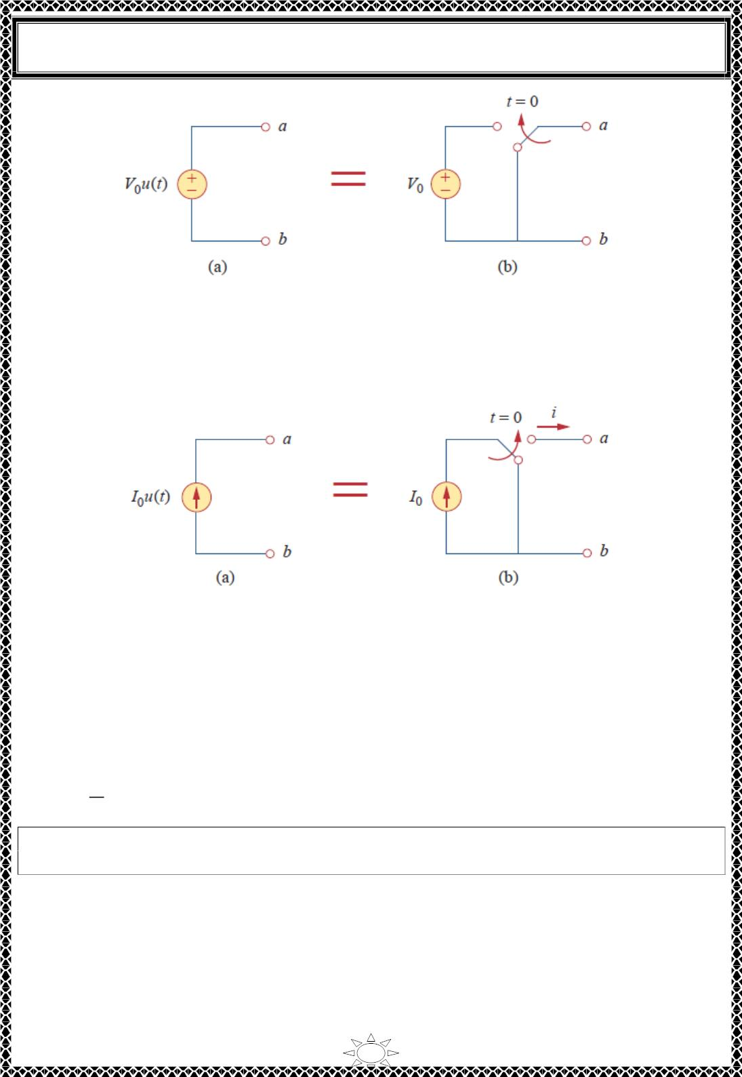
University of Diyala
Engineering College
Electrical Circuits
Fig.4.3 (a) A voltage source of 푉₀푢(푡) (b) its equivalent circuit.
for 푡 > ꢀ. Similarly, a current source of 퐼₀푢(푡) is shown in Fig.4.4 (a), while its equivalent
circuit is in Fig.4.4 (b). Notice that for 푡 < ꢀ, there is an open circuit (ꢁ = ꢀ) , and that ꢁ =
퐼₀ flows for 푡 > ꢀ.
Trail Version
Trail Version
Trail Version
Trail Version
Trail Version
Trail Version
Trail Version
Trail Version
Trail Version
Trail Version
Trail Version
Trail Version
Trail Version
Fig.4.4 (a) A current source of 퐼₀푢(푡) (b) its equivalent circuit.
4.2) Unit impulse function
The derivative of the unit step function 푢(푡) is the unit impulse function (or delta function)
휹(풕) , which we write as
푑
ꢀ
푡 < ꢀ
푡 = ꢀ
푡 > ꢀ
훿(푡) =
푢(푡) = {푈푛ꢃ푒푓ꢁ푛푒ꢃ
ꢀ
(4.6)
푑ꢂ
The unit impulse function 훿(푡) is zero everywhere except at t = 0, where it is
undefined.
Impulsive currents and voltages occur in electric circuits as a result of switching
operations or impulsive sources. Although the unit impulse function is not physically
realizable (just like ideal sources, ideal resistors, etc.), it is a very useful mathematical
tool.
15

Slide 9
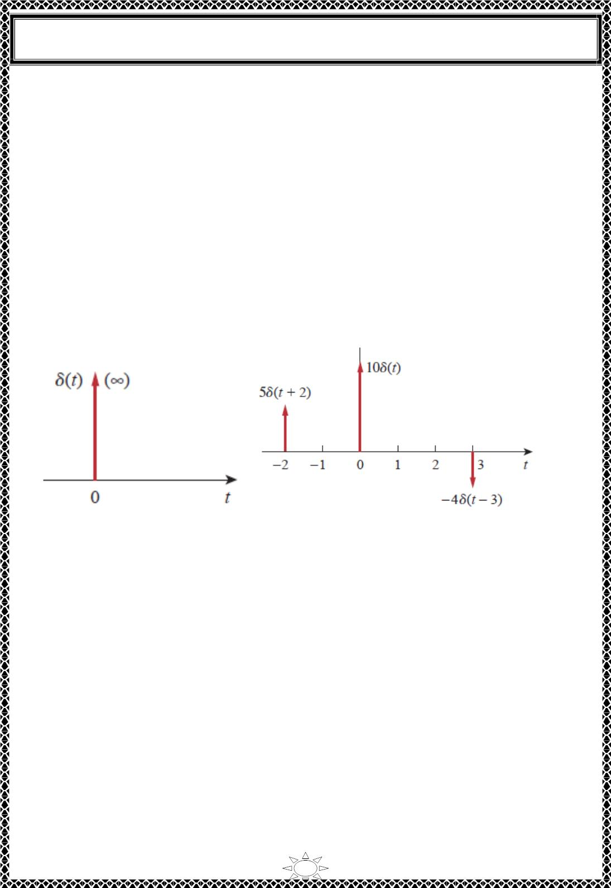
University of Diyala
Engineering College
Electrical Circuits
The unit impulse may be regarded as an applied or resulting shock. It may be visualized as
a very short duration pulse of unit area. This may be expressed mathematically as
₀+
(4.7)
푡 = ꢀ
∫ 훿 (푡)푑푡 = 1
0−
ꢁ
and is the time just after
푡 = ꢀ^{ꢂ}
where 푡 = ꢀ denotes the time just before
푡 = ꢀ
.
For this reason, it is customary to write 1 (denoting unit area) beside the arrow that is used
to symbolize the unit impulse function, as in Fig.4.5. The unit area is known as the
strength of the impulse function. When an impulse function has a strength other than
unity, the area of the impulse is equal to its strength. For example, an impulse function
1ꢀ훿(푡) has an area of 10. Fig.4.6 shows the impulse functions 5훿(푡 ꢃ 2), 1ꢀ훿(푡) , and
ꢄ4훿(푡 ꢄ 3) .
Trail Version
Trail Version
Trail Version
Trail Version
Trail Version
Trail Version
Trail Version
Trail Version
Trail Version
Trail Version
Trail Version
Trail Version
Trail Version
Fig.4.5 The unit impulse function.
Fig.4.6 Three impulse functions.
To illustrate how the impulse function affects other functions, let us evaluate the integral
푏
(4.8)
ꢅ 푓 (푡)훿(푡 ꢄ 푡 )푑푡
푎
0
where ꢆ < 푡 < ꢇ. Since 훿(푡 ꢄ 푡 ) = ꢀ except at 푡 = 푡 , the integrand is zero except at 푡 .
Thus,
0
0
0
0
푏
푏
푏
ꢅ 푓 (푡)훿(푡 ꢄ 푡 )푑푡 = ꢅ 푓 (푡 )훿(푡 ꢄ 푡 )푑푡 = 푓(푡 ) ꢅ 훿 (푡 ꢄ 푡 )푑푡 = 푓(푡 )
푎
0
푎
0
0
0
푎
0
0
푏
ꢅ 푓 (푡)훿(푡 ꢄ 푡 )푑푡 = 푓(푡 )
푎
0
0
(4.9)
This shows that when a function is integrated with the impulse function, we obtain the
value of the function at the point where the impulse occurs. This is a highly useful
16

Slide 10

University of Diyala
Engineering College
Electrical Circuits
property of the impulse function known as the sampling or sifting property. The special case
of Eq. (4.8) is for 푡₀ = ꢀ. Then Eq. (4.9) becomes
+
0
(4.10)
∫ 푓 (푡)훿(푡)푑푡 = 푓(ꢀ)
0−
4.3) Unit ramp function
Integrating the unit step function 푢(푡) results in the unit ramp function 풓(풕) ;
ꢁ
푟(푡) = ∫ 푢 (푡)푑푡 = 푡푢(푡)
or
(4.11)
(4.12)
ꢂ∞
ꢀ, 푡 ≤ ꢀ
푟(푡) = {
푡, 푡 ≥ ꢀ
The unit ramp function is zero for negative values of t and has a unit slope for
positive values of t.
Fig.4.7 shows the unit ramp function. In general, a ramp is a function that changes at a
Trail Version
Trail Version
Trail Version
Trail Version
Trail Version
Trail Version
Trail Version
Trail Version
Trail Version
Trail Version
Trail Version
Trail Version
constant rate.
Trail Version
The unit ramp function may be delayed or advanced as shown in Fig.4.8. For the delayed
unit ramp function,
ꢀ,
푟(푡 ꢃ 푡₀) = ꢄ
푡 ꢃ 푡 , 푟 ≥ 푡
and for the advanced unit ramp function,
푡 ≤ 푡₀
(4.13)
0
0
ꢀ, 푡 ≤ ꢃ푡₀
푟(푡 ꢅ 푡₀) = ꢄ
푡 ꢅ 푡₀, 푡 ≥ ꢃ푡₀
(4.14)
We should keep in mind that the three singularity functions (impulse, step, and ramp) are
related by differentiation as
훿(푡) =
푑푢(푡)
푑푡
푢(푡) =
푑푟(푡)
푑푡
(4.15)
(4.16)
,
or by integration as
푢(푡) = ∫_{ꢂ}ꢁ∞ 훿 (푡)푑푡,
ꢁ
푟(푡) = ∫ 푢 (푡)푑푡
ꢂ∞
17

